Slide 1
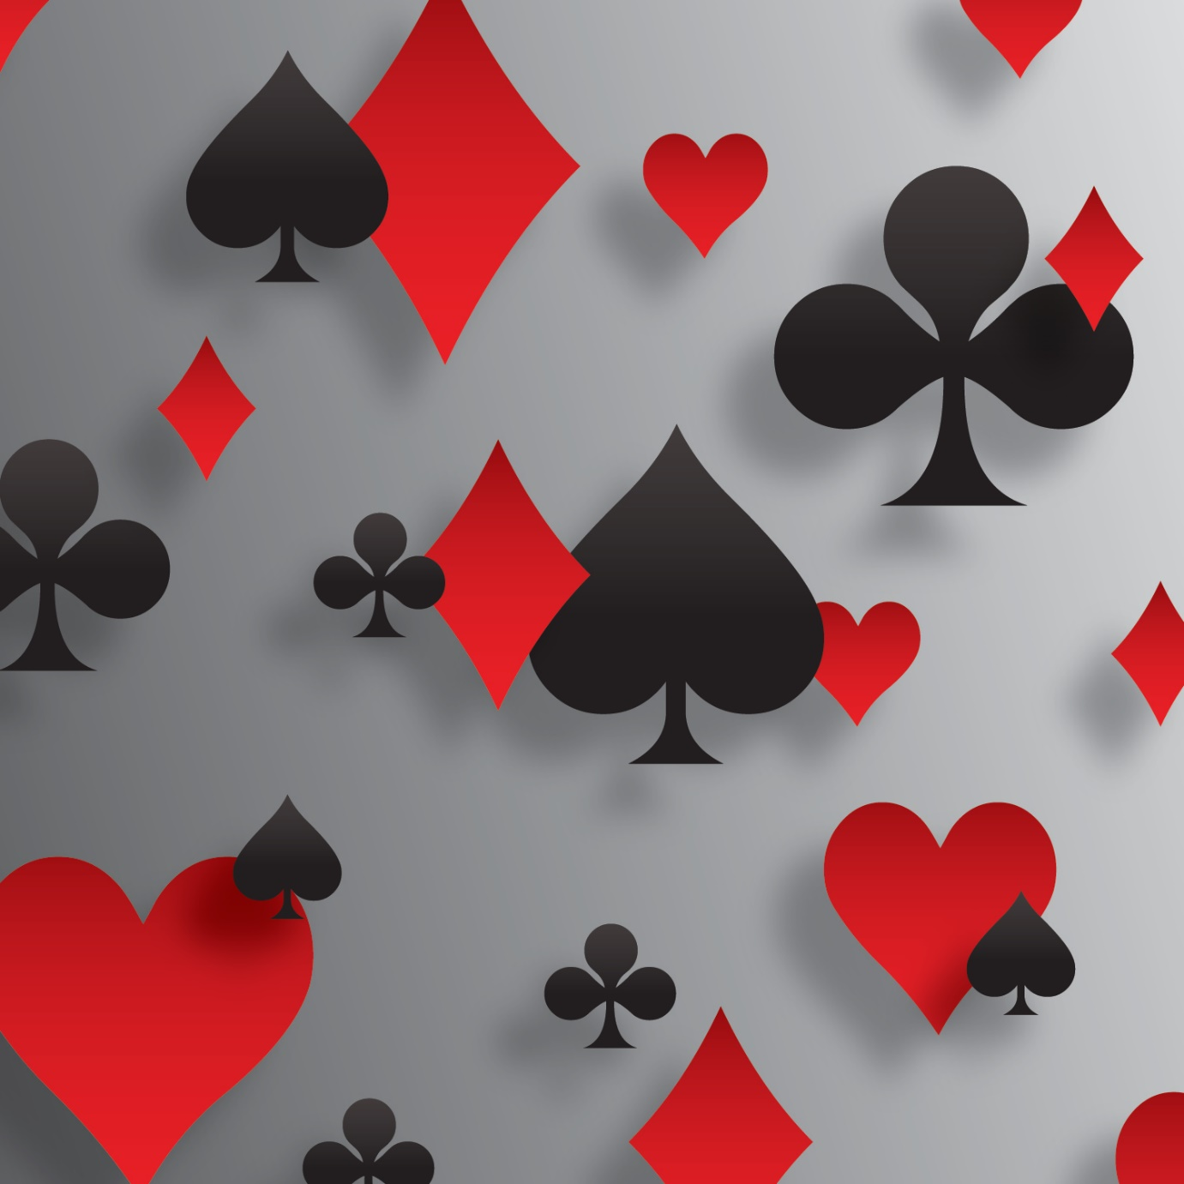
Bridge Workshop Double! – new meanings for the World’s Oldest Bid

Slide 2
Workshop Agenda
Take out doubles
Negative Doubles (with a new idea)
Opener reply after a Negative Double
Support Doubles and Redoubles
Maximal Double
Responsive Double after partner doubles
Responsive Double after partner bids a suit
Cue bid Double
Honour showing Doubles and Redoubles
Double of splinters
Doubles when they cue bid a suit we have bid
Don't lead me Double
Double of cue bids when they looking for slam
Double of game tries
Doubling a 4th suit bid
Snapdragon Double
Lightner Doubles
Action Double
Lawrence Doubles
Stripe tailed ape Double

Slide 3
Overconfidence
In one psychological study, young adults were asked to rank themselves
100% put themselves in top half of population
60% rated themselves in top 10%
25% humbly thought they were in the top 1% of population

Slide 4
Take out double
Understanding Takeout Doubles and the follow-ups is probably more important than any other part of bidding. They come up more often than any convention.
LET’S GET RID OF BAD HABITS
HAVE A CONSISTENT SYSTEM THAT IS SIMPLE AND WE CAN PLAY IT WITH ALL
PARTNERS even Robots

Slide 5
One of the secrets of good bridge communicating to partner every time we get a chance to bid
How many points do we have?
Are we balanced or unbalanced?
What suits do we hold?
Imagine been stranded in a jungle and the only way of communicate your bid is to leave a message on the monolith

Slide 6
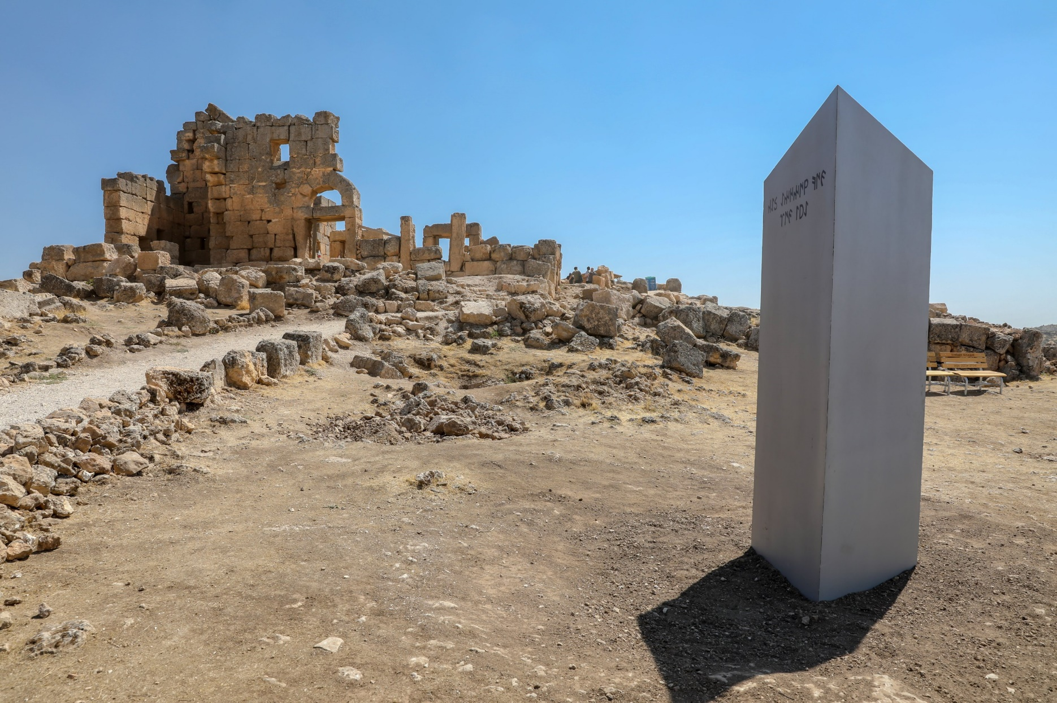
Write on the Monolith for your partner every time you get the chance to write
Points | Balanced | Unbalanced
>20
18-19
15-17
12-14
8-11
5-8
0-4

Slide 7
Takeout double
Double (X) is the most versatile and flexible bid in bridge.
The TYPICAL take out x is called SOS doubles (Shortage Opening hand and Support)
The double doesn’t take up any bidding room and works well when other bids are not practical. The Classic Takeout Double shows
shortage (ideally two or fewer cards) in the opponent’s opened suit
an opening hand (add extra for shortage)
support for the suits not opened by the opponents
A double is forcing, (unless the next hand bids after it), and asks partner to bid their longest suit, even with no points, and indicate their point range. The higher the level opened (e.g. pre-empts at the two+ level), the stronger the doubler needs to be. But, with very few cards in the opponents’ suit, you should try to enter the auction with a double. The more points you hold, the less important is the shape requirement

Slide 8
Take out Double
Unbalanced hands
11+ shortage in suit opened and support for other suits
Usually, it’s better to overcall than double with a 5-card or longer suit, particularly a major. Overcall 8-17 points
But if you have a very strong hand with a good suit, like
♠ AKxxxx ♥ Ax ♦Ax ♣ Kxx, you need to take stronger action to make sure the hand doesn’t get passed out.
In the old days, you could bid 2♠ over an opening 1 bid to show this hand. As bidding evolved, people realized that these strong jump overcalls were rare, and it was more valuable to play preemptive jump overcalls.

Slide 9
WHAT DO WE BID AFTER RHO BID OF 1♠ ?
Hand 1
Hand 2
Hand 3
♠ | A82
♥ | 43
♦ | KJ87
♣ | AQ42
♠ | A8
♥ | KJ43
♦ | J982
♣ | KJ2
♠ | Q982
♥ | A43
♦ | 87
♣ | AQ42
Hand 4
Hand 5
Hand 6
♠ | AQT98
♥ | 6
♦ | T65
♣ | AK54
♠ | AJT2
♥ | 4
♦ | KQ87
♣ | AQ42
♠ | AJT2
♥ | KQ87
♦ | 4
♣ | AQ42
Hand 7
Hand 8
Hand 9
♠ | 2
♥ | K3
♦ | KQJ87
♣ | AJT42
♠ | 982
♥ | KJ3
♦ | KJ8
♣ | KJ42
♠ | AT
♥ | AKT94
♦ | Kx
♣ | ATxx

Slide 10
WHAT DO WE BID AFTER RHO BID OF 1♠ ?
Hand 1
Hand 2
Hand 3
Hand 4
Hand 5
Hand 6
Hand 7
Hand 8
Hand 9

Slide 11
No mistakes -1100

Slide 12
WHAT DO WE BID AFTER RHO BID OF 1♠ ?
Hand 1
Hand 2
Hand 3
♠ | A82
♥ | 43
♦ | KJ87
♣ | AQ42
♠ | A8
♥ | KJ43
♦ | J982
♣ | KJ2
♠ | Q982
♥ | A43
♦ | 87
♣ | AQ42
Hand 4
Hand 5
Hand 6
♠ | AQT98
♥ | 6
♦ | T65
♣ | AK54
♠ | AJT2
♥ | 4
♦ | KQ87
♣ | AQ42
♠ | AJT2
♥ | KQ87
♦ | 4
♣ | AQ42
Hand 7
Hand 8
Hand 9
♠ | 2
♥ | K3
♦ | KQJ87
♣ | AJT42
♠ | 982
♥ | KJ3
♦ | KJ8
♣ | KJ42
♠ | AT
♥ | AKT94
♦ | Kx
♣ | ATxx

Slide 13
WHAT DO WE BID IF RHO OPPONENT XXs AFTER OUR PARTNERS X OF 1♣ ?
Hand 1
Hand 2
Hand 3
♠ | A872
♥ | 743
♦ | Q3
♣ | 9874
♠ | A872
♥ | Q543
♦ | 5
♣ | 9874
♠ | QT9875
♥ | 43
♦ | T82
♣ | 74
Hand 4
Hand 5
Hand 6
♠ | A872
♥ | Q54
♦ | A32
♣ | 987
♠ | A872
♥ | Q543
♦ | A3
♣ | 987
♠ | A87
♥ | 743
♦ | Q32
♣ | 9874

Slide 14
WHAT’S OUR BID AFTER RHO 1♣ ?
Hand 1
Hand 2
Hand 3
♠ | A872
♥ | AK743
♦ | QJ2
♣ | 4
♠ | AJ82
♥ | KJ3
♦ | A9875
♣ | 4
♠ | AK82
♥ | 76432
♦ | AQ3
♣ | 7
Hand 4
Hand 5
♠ | T98
♥ | K43
♦ | AQJT2
♣ | A2
♠ | 2
♥ | K3
♦ | KQJ87
♣ | AJT42

Slide 15
RESPONDING TO A TAKEOUT DOUBLE
Suppose you have this hand:
Hand 1 ♠ Axxxx ♥ KJx ♦ Ax ♣ xxx.
Or
Hand 2 xxxx ♥ xxx ♦ xxx ♣ xxx.
If partner opens 1 ♣ or 1 ♦ or 1 ♥, and you bid 1 ♠ on 1st hand
No problem, it’s forcing, partner must bid again, and you can make sure you get to game.
We Pass on 2nd hand but must bid 1 ♠ over x
I’ve seen people respond 1 ♠ to a takeout double with the first hand, but this is wrong! WHY?
Your partnership has at least 8 spades, so you are positive you want to play in spades. There’s no need to explore for a trump fit.
Your partner has opening bid values, so your side has enough to bid game. Therefore, bid 4 ♠ immediately!
There’s no reason to mess around when you know what the final contract should be.
1 ♠ should not be forcing

Slide 16
What do we bid?
LHO opens 1♣ and partner doubles and we hold
1. ♠ Axxxx ♥ KJx ♦ Ax ♣ xxx.
2. ♠ xxxx ♥ xxx ♦ xxx ♣ xxx.
3. ♠ Axxx ♥ KJxx ♦ Ax ♣ xxx
4. ♠ Axxx ♥ KJxx ♦ Qx ♣ xxx.
LHO opens 1♣ and partner doubles and we bid 1 ♠ on the hand below
♠ Axxx ♥ xx ♦ Kxx ♣ xxx
Partner now bids a NT what now?

Slide 17
RESPONDING TO A TAKEOUT DOUBLE
SUPPOSE you hold again LHO opens 1♣ and partner doubles and we hold
5. ♠ Qxxx ♥ KJxx ♦ Kx ♣ xxx. Or
6. ♠ QTxxx ♥ KJx ♦ Kx ♣ xxx
Hand 5, are you sure you want to be in game? No, not if partner has a minimum.
So you make an invitational bid: 2 ♠ . This shows 8-11 points and 4 spades. With 4-4 in the majors, bid spades first and if you are strong enough to rebid, then you can rebid hearts, which gives partner an option. This is another difference from “normal” bidding.
With Hand 6 ♠ QTxxx ♥ KJx ♦ Kx ♣ xxx you make an invitational bid: 3 ♠ . This shows 8-11 points and 5+ spades. The difference between the 2 and 3 level here is the length in ♠

Slide 18
RESPONDING TO A TAKEOUT DOUBLE with their suit
Suppose you have one of these hands your longest suit is their suit: then what? :
1. ♠ xx ♥ Qx ♦ xxx ♣ Jxxxxx or
2. ♠ xxx ♥ xxx ♦ xxx ♣ KJxx. or
3. ♠ xxx ♥ Kxx ♦ Jx ♣ Txxxx
You can bid NT if your hand is reasonably balanced, and you have enough strength, but you MUST bid something else if you have a weak hand.
Rarely, you will have a hand where it is correct to pass!
But you need a good hand and good trumps to do this:
4. ♠ xx ♥ JTx ♦ AJx ♣ QJT97.
BY THE WAY IF PARTNER PASSES YOUR DOUBLE FOR PENALTIES
Best I to lead a trump (if you have one).

Slide 19
SUMMARY OF RESPONSES TO TAKE OUT X
Points | Bid
Less than 8 points | We bid our longest suit If no 4 card suit then aim to bid minor or 3-card ♠ over 1♥
If we have 8- 11 | We jump in our 4-card suit With 5 we jump to 3 level
IF we good 11 + | We bid game with 5 or cue bid their suit with 4 A cue bid is forcing to suit agreement
With 8+ points and stopper(s) and no major | We bid NTS at appropriate level
With a good hand and good trumps | We Pass
With a monster | We bid opener’s suit and then ours It should be forcing until suit agreement

Slide 20
Balancing Double Situation
When the bidding goes
1 of a suit Pass, Pass, a double in the pass out seat – meaning the last person to bid, is regarded as a balancing double.
Strength Requirements for Balancing Double
Any point range above 8 HCP. Usage depends on the prior bidding in the auction and the vulnerability. The Doubler always promises holdings of the suits not bid. We should have at least 4-3 in the major suits if the opposition have bid only the minors
THE RULE FOR BIDDING AND RESPONDING is to TRANSFER THE VALUES OF A KING
If we add the value of a KING in the balancing position then partner must subtract the value of a KING otherwise, we will likely overbid ☺
Balancing doubles will be dealt with by BERNARD DONDE so I will not deal with them

Slide 21
Partnership should agree when Doubles are NOT INFORMATIVE but for penalties Doubles are NOT for penalties unless
It is a penalty double of a weak no trump
The doubling hand has had or HAS sufficient room to already describe their hand type and values.
It is a double of an opponent’s contract at a late stage in the auction when we have been silent throughout
It is a Lightner double.
If either you or your partner has made a preemptive bid and the other doubles, it’s penalty. (IT IS NOT NEGATIVE). Example: 3 ♦ 3 ♥ DBL is penalty.
We bid a suit at the one level, the opponent bids 1NT X by us is logically for penalties NOT TAKEOUT NOT RESPONSIVE NOT SUPPORT etc. all illogical
If a penalty double has been made, then all subsequent doubles are for penalties.

Slide 22
Negative doubles
Negative doubles were popularized by the late American expert Al Roth, who coined the convention "Sputnik" -the first Soviet satellite to be launched into space in 1957. The implication was that the double was the start of a space age in bridge.
The minimum strength required for a negative double is about
6+ Points over 1 level overcall,
8+ over 2 level overcall and
9/10+ over 3 level overcall.
There is no upper limit for the strength of a negative double.
A negative double usually shows 4 cards in the unbid suit(s), although it may also be made with a 5-card or longer suit in a hand too weak to bid it directly.
Note also that a negative double usually denies support if partner has bid a Major
Negative doubles apply over jump overcalls up to 3 ♠ (some partnerships also play them against higher overcalls).
Negative double at 1 level shows both Majors playing SAYC /BBO at 2 level promises 1 Major

Slide 23
Negative Doubles (aka "Sputnik") What do we bid over 1♣ 1♦ ?
Player | X | 1 ♥ | 1♠
Neville and Tim | 4♠ no 4 ♥ | 4+♥ may have 4♠ | 5+♠
SAYC and Robots | 4♥ + 4♠ | 4+♥ Possible 4 ♠ only if 5+♥ | 4+♠

Slide 24
Negative doubles
Partner | RHO | US | LHO
1♦ | 1♠ | X | Pass
2♣ | Pass | 2♥
North | East | South | West
1♦ | 1♠ | ?
What do we BID ?
Partner’s hand
♠ | 982
♥ | AQJT43
♦ | J8
♣ | 42
♠ | Q86
♥ | 6
♦ | AQ432
♣ | KQ76
Partner | RHO | US | LHO
1♥ | 2♦ | X | Pass
Shows 4 spades with 7+ points or 5+ spades with 7-9 points
with 5+ spades and 10+ points, responder can bid 2S instead.

Slide 25
Negative doubles Response by opener
With 4+ cards in partner's shown suit, opener can bid it at the cheapest level with a minimum hand.
Lacking 4 cards, opener can do one of the following:
Rebid a 5-card (preferably at least 6-card) suit.
Bid notrumps with a stopper in the enemy suit.
Bid a new suit naturally (a reverse still shows a strong hand).
Cue-bid the enemy suit with a strong balanced hand that lacks a stopper in that suit.
Bid partner’s known suit with only 3 cards (last resort).# But note following
Partner | RHO | US | LHO
1♣ 1♠# | 1♥ | X | Pass
# Many partnerships NOW PlAY this as 3 ♠ with no other suitable bid

Slide 26
Negative doubles Response by opener
In case you think the opponents are always friendly enough to overcall at the one level, think again.
Opponents are forever making weak jump or 2 suited (Ghestem/Michaels) overcalls to make life difficult
Your defense is usually a negative double but what does a negative double mean at the three level?
A double promises a good hand 10+ points , without a long suit to bid.
It says to your partner, “We have the majority of the high-card points so DSIP Do Something Intelligent Partner !”
Partner 1♣ | RHO 3♥ | US X
♠ | A98(2)
♥ | 32
♦ | AT87
♣ | KJ5(2)

Slide 27
What do we bid?
North | East | South | West
1♣ | 1♥ | X | 2♥
Pass | Pass | ?
We hold as South -what do we bid?
Hand 1
Hand 2
Hand 3
♠ | Q982
♥ | 432
♦ | 87
♣ | AQ42
♠ | AK72
♥ | 432
♦ | 87
♣ | KT65
♠ | Q982
♥ | 43
♦ | KJ32
♣ | AJ6

Slide 28
What do we bid?
Opener | LHO | Partner | RHO
1♦ | 1♥ | X | Pass
?
We hold as opener -what do we bid?
Hand 1
Hand 2
Hand 3
♠ | AQ82
♥ | K32
♦ | KT872
♣ | 2
♠ | KQJ2
♥ | 2
♦ | AKQ87
♣ | T65
♠ | AQ8
♥ | J32
♦ | KT87
♣ | AT5

Slide 29
Opener reply after a negative double
N E S W
1 ♣ 1♥ X 2♥
X
What does the double mean is it penalty? Is it takeout? Is it something else?
The double is takeout. Opener NORTH promises something like
♠QJx ♥x ♦AJxx ♣ AQJxx
Minimum point count 14-15+
You could belong in ♠ ♦ or ♣s
How does partner bid in response?
SOUTH HANDS | BID
1 ♠KTxx ♥Kxx ♦Qxx ♣ xxx | BID 2 ♠
2 ♠Txxx ♥Jxxx ♦Kx ♣ Kxx | BID 3 ♣
3 ♠Axxx ♥xxx ♦KT9x ♣ xx | BID 3 ♦
4 ♠AKTx ♥xxx ♦xxx ♣ Kxx | BID 4 ♠
5 ♠Axxx ♥QJTx ♦Qxx ♣ xx | How about a Pass

Slide 30
Support Doubles and Support Redoubles
The Support Double and redoubles was devised by Mr. Eric Rodwell, and is a method that enables the opening bidder to clarify or show precisely the degree of support of the suit of the partner or responder. This occurs in a competitive auction, in which an opponent interferes at a low level
HAND 1
N E S W
1♦ P 1♥ 1♠
2♥ 2♠ ?
Your hand in ♠xxx ♥KJ9x ♦AQx ♣ Jxx (How many ♠s has E got)
I will tell you how many ♥ s North has
I will tell you how many points North has
How many ♠s
HAND 2
N E S W
1♦ P 1♥ 2♠
Note if you partner cannot respond in his suit at 2 level Responsive Xs are no longer applicable - the X now shows a good hand not necessary 3 trump
X = Good hand
3 ♥ = 4 ♥ not a minimum
2NT = GOOD Bad 15-17 with stopper ?

Slide 31
What is maximal double in bridge?
A maximal double is a type of cooperative double used when your side has found a major-suit fit in a competitive auction. It distinguishes major-suit game tries from competitive bids at the 3-level
Maximal means “constituting a maximum”

Slide 32
Maximal (Invitational) Doubles
Maximal (Overcall) Double - When both sides have a suit agreement (Opponents Bid And Raise - OBAR in lower suit), a double invites game, while a suit bid is merely competitive
Bidding
N E S W
1♦ 1♠ X 2♠
3♥ ?
? A X=Invitational and 3♠=Competitive
Example
East East
AQxxxx AQxxxx
♥ Ax xxx
♦ xx x
AQx AJxx

Slide 33
Maximal (Invitational) Doubles and at last a PENALTY DOUBLE
Bid | Meaning
(1♥) - 1♠ - (3♥) – 3 ♠ | 3S is merely a competitive bid to play with no interest in bidding game
(1♥) - 1♠ - (3♥) – X | X shows interest in game if partner has extra values
1♠ - (2♦) - 2♠ - (3♦); X | X shows interest in game if partner has extra values 1.Pass is the decision to defend against 3 D by the opponents 2.A bid of 3H, since there is room for this bid, is reserved as game generally invitational. and is definitely forcing to 3 Spades. This bid is considered to be conventional 3.A bid of 3S is generally agreed to mean a sign-off in the original suit. 4.A double can then be considered to be and/or converted to a penalty double. This is an optional partnership agreement NOTE PENALTY DOUBLESS APPLY ONLY IF WE HAD THE SPACE TO SHOW OUR STRENGTH If opponents overcalled 2♣ and opponents raised to 3♣ then X is PENALTIES
(1♦) - 1♥ - (2♦) - 2♥; (3♦) - P - (P) – X | X here is a cooperative (optional) Double, primarily interested in penalizing opponents since partner did not actively raise to 3H
(1♣) - 1♥ - (2♣) - P; (P) - 2♥ - (3♣) - X | X here is for penalty - no fit with partner in Hearts

Slide 34
Maximal (Invitational) Doubles
The Maximal Double is not only on by Opener, here’s an example when the Overcaller can use the convention:
West North East South
1♥ 1♠ 2♥ 2♠
3♥ ??
Yes, it’s the same basic situation!
Here’s another sequence
West North East South
Pass Pass 1♥ Dbl
2♥ 2♠ 3♥ ??
Yes, a similar type of auction. South has introduced Spades into the auction, albeit indirectly, North has raised, and South can now make a game try via the same Maximal Double

Slide 35
6. Responsive double after partner Doubles
After partner doubles
If bidding goes
(1♦) – X– (2♦) - ?
♠ Q9xx ♥ Jxxx ♦ ATx ♣ 10x
Responsive double is used only when
If the opponents are bidding a Minor we promise both Majors
If the opponents are bidding a Major we promise both Minors
Your partnership must decide how high to play them (Experts suggest up to 4 ♦)

Slide 36
Responsive double
BIDDING | HAND | BID
(1♦) X (2♦) ? | ♠AJxx ♥Txxx ♦xx ♣ Jxx | X
(1♣) X (2♣) ? | ♠AQxx ♥KJxx ♦Jx ♣ xxx | X
(1♠) X (2♠) ? | ♠xxx ♥Jx ♦AT9x ♣ QJxx | X
(1♠) X (2♠) ? | ♠Jxx ♥Qxxx ♦AQTx ♣ xx | 3♥some x and then 3 ♥ s to show a weak ♥ bid
(1♦) X (3♦ ) ? | ♠QJxx ♥KT9x ♦xxx ♣ Kx | X and then guess?
(1♥) X (3 ♥ ) ? | ♠xxx ♥x ♦AJxxx ♣ KQxx | X as bidding gets higher we need more values
(1♦) X (4♦ ) ? | ♠KQxx ♥Qxxx ♦x ♣ KJxx | X
(1♥)X (4 ♥) ? | ♠Qxx ♥ xx ♦ AJxxx ♣ KT9 | X This is higher than 4♦ so X is no longer responsive but akin to an action X

Slide 37
7. Responsive double after p bids suit
Like a negative double used by the side that is competing
After partner overcalls
Responsive double is used only when they open and raise (1♣)– 1 ♠– (2♣) - ?
A responsive double tends to imply often 55 and enough points to comfortably compete
Denies trump support for partner’s overcall
You do not have the same expectancy now for a fit
If we have cards in their suit p has more room for ours – we can be more aggressive
Experts suggest playing them to 3 ♦ but Lawrence et al suggests this may be too high –see later

Slide 38
Responsive double after overcall
If bidding goes
(1♣)– 1 ♠– (2♣) - ?
Hand 1
♠x ♥ KQJx ♦ ATxxx ♣ Jxx
Hand 2
♠xx ♥ QJxxx ♦ KQxxx ♣ x
Note that your p can bid at 2 level but you may strike out
♠KQ9xx ♥ xx ♦ Tx ♣ AJxx
P has nice overcall but you have not a fit so you may get yourself into trouble

Slide 39
Responsive double after an overcall
BIDDING | HAND | BID
(2♥ ) 3♦ (3 ♥) ? |  | This is too high for a responsive double and we are unlikely to have ♥ s so the meaning of X can be different Some play it as ACTION others as saying I would have cue bid 3♥ had RHO not bid
Lets assume we have never discussed it with this partner before
What does p know
They have at least 9 cards in ♥ + what partner holds
Partner must have values as we may be going to next level
Partner will have some support for ♦
What is vulnerability Pairs or Teams
Am I very distributional e.g. 6♦ and 4 ♠

Slide 40
8. Cue bid raise double
Should we be playing responsive doubles after overcalls at all. What about using it to show a cue –bid raise
(1♦)– 1 ♥– (3♦) - ?
♠Jxx ♥ Qxx ♦ xx ♣ AKJxx
Jeff Ruben argued in 1968 that the number of times a responsive double would be used was less than the cue bid raise
(1 ♠)– 2 ♥–(2 ♠) - ?
You hold a good raise or bad We can use good bad and the x is still responsive WHAT ABOUT GOOD BAD NT

Slide 41
Cue bid double
(1♦) -1♥– (3 ♦)-?
If you have 7-9 it is easy to bid 3 ♥ but what if we hold 11 or 12
♠Jx ♥ Kxxx ♦ xxx ♣ KTxx
♠Kx ♥ KQx ♦ xxx ♣ QJxxx
MY PREFERNCE IS THAT IT IS A GOOD RAISE –HERE I AM WITH RUBENS
ON FREQUENCY IT SEEMS THE BEST USE

Slide 42
9.Honour showing Doubles and redoubles
(1♦) – 1 ♠–(X)- XX
We play this as Hx specifically Where H = A, K or Q
What about
(1♦)- 1 ♠– (2 ♠) - X
What does this show? This needs PARTNERSHIP agreement.

Slide 43
10. Doubles of splinters
(1♥)– P–(4♦)*- X
*Splinter
What does X mean?
It asks partner to lead suit
♠JT9x ♥ x ♦ KQTxxx ♣ Jxx
It tells partner you are willing to compete in splinter suit
♠9x ♥ x ♦ AQTxxx ♣ Kxxx
It is a lead directing double for lowest, highest unbid suit IF WE HAVE PASSED
♠KQT9 ♥ xx ♦ Jxxxx ♣ Jx
♠ Jx ♥ xx ♦ Jxxxx ♣ KQT9
33

Slide 44
Doubles of splinters bids
(1♥)– P–(4♦)*- X
* splinter
What do the experts suggest
Lead directing for ♦ s not a good idea
Non Vul and not having passed save suggestion
Otherwise Lead directing for lowest suit or unbid suit

Slide 45
11. Doubles when they cue bid a suit we have bid
(1♣)–1 ♠- (2♠) x
Most play 2 ♠ =shows a good hand with support
What does x mean
X should contribute to auction and not be ego strutting
We would have raised to 2 ♠? We show Hx or Hxx?
(1 ♥) –1 ♠- (3 ♠ )x
Most play 3 ♠ as a splinter or a good raise to 4 ♥
What does x mean
X should contribute to auction
You are telling partner that you have a hand that is willing for him to bid 4 ♠ usually as a sacrifice
♠Jxxx ♥ xxx ♦ Kxxx ♣ xx

Slide 46
Doubles when they cue bid a suit we have bid
(1♣)–1 ♠- (2 ♣) P
2 ♠- X
X showing good ♠’s is foolish and nothing extra partner will lead a ♠ anyway and the x gives opponents another round of bidding
What should a x mean?
One meaning would be to say you have a good playing hand and would like to compete
♠AQJxx ♥ xx ♦ KJTx ♣ x
(1♥)–1 ♠- (2 ♦) P
(3♦) -P – (3 ♠ ) X
X should contribute to auction
Best Hx or Hxx
X is important as when you dont have a honour P will draw the correct inference

Slide 47
12. Don't lead me double
(1♦)-1 ♠- (3 ♦ ) - P
(3 ♠)-X
♠Qxxxxx ♥ AKJx ♦ x ♣T x
X should contribute to auction
Looks like they are going to play in 3NT
X says I don't like ♠’s please lead another suit
Pass says I like a ♠ lead
X showing good ♠’s is foolish p will lead a ♠ anyway and the x gives opponents another round of bidding

Slide 48
13. Double of cue bids when they looking for slam
(1♠)–P- (2 ♦)–P
(2♠)-P-(3♠)-P
(4♣)
♠xx ♥ JTxx ♦ xxx ♣KQTx
Should we X with
If we are on lead DEFINITELY NOT
It is better to X when we hold
♠xx ♥ KQJ ♦ xxxx ♣xxxx ☺
(1♠)–P- (3 ♠)- P
(4♣)-P-(4 ♥)-X
If we hold ♠xx ♥ KQJx ♦ xxx ♣xxx x
We desperately want a ♥ lead
What about
♠xxx ♥ QJTx ♦ xxx ♣Q x

Slide 49
14.Double of game tries
(1 ♠)–P- (2 ♠) - P
(3 ♦)–?
You hold
♠QJx ♥ xx ♦ KJ9xx ♣Jx x
Should we X
NOOOOOOOOOO
This will help the opponents in the bidding and play
After your helpful hint they may stop in 3 and to add insult to injury make it

Slide 50
15. Doubling a 4th suit bid
(1♦)–P- (1 ♥ ) - P
(1 ♠)- P- (2♣) X
the 2 ♣ would typically hold
♠Kxx ♥ AJxxx ♦ AJ ♣Jx x
You hold
♠Jxx ♥ Txxx ♦ x ♣AQTx x
Should we X
YES! it is likely that they will bid NTs and we want a ♣ lead

Slide 51
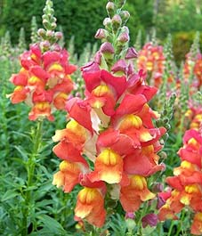
5. Snap dragon double
The word snapdragon derives from
a genus of plants commonly known as
snapdragons These flowers resemble
the face of a dragon that opens and closes its mouth when laterally squeezed, which as a result produces a snap-like sound.
The reason for this designation is that the Snapdragon double can only be triggered by the player in the fourth seat after the three previous players have each bid a different suit.

Slide 52
Snap dragon
Snapdragon double (also known as
competitive double and fourth-suit
double).
A bid of double by fourth hand, when three different suits have been bid by the first three players and shows a good holding in the fourth suit (generally six cards, though some partnerships allow five) and tolerance for partner's suit.

Slide 53
Snap dragon
If you choose to make Snapdragon part of your partnership agreement you should agree on:
The maximum level to which it can apply. (The generally accepted guideline is not to employ it beyond the two-level).
The preferred minimum strength (usually 5)
Not enough to bid freely
Features of the doubling hand at each level “Tolerance” is almost always a doubleton

Slide 54
Snap dragon
Hand 1
(1♦)- 1♥ – (1♠)- X shows something like
♠ Kxx ♥ Qx ♦ xx ♣ QJ10xxx or
Hand 2
(1♣)- 1♥ – (1♠) -X
♠ T97x ♥Jx ♦ AKJxx ♣ xx
Shows 5 in unbid suit “tolerance” in p’s suit (doubleton)
What is “tolerance” Tolerance is 2

Slide 55
16. Lightner Doubles of slams
Bid | Lead
1♠ P 2♣ P 2♥ P 4NTP 5 ♦ P 6NT P P X | ♠xxxxx ♥T9 ♦T987 ♣ Jx
3♠ P 4NT P 5 ♦ P 6♠ X | ♠6 ♥QT98432♦ QJT9 ♣4 Assuming no one is mad the double does not suggest 2 Aces

Slide 56
16. Lightner Doubles of contracts
Bid | Lead
1♥ P 2♣ P 2♥ P 4♥ X | ♠Axx ♥xx ♦Qxx ♣J9842
1 NT P 3NT X | There are many variations You figure out which suit I want (since I have long suit P leads shortest usually a Major) Sometimes P play is for ♥ s or if Stayman was used for ♦ s or if Stayman was not used for ♣s
1♣ P 1♥ P 1NT P 3NT X | We X on any of the following hands ♠xxx ♥AKQTx ♦Txx ♣ xx ♠xx ♥KQJ9x♦xxx ♣ Axx ♠Axx ♥QJT8x ♦Ax ♣ xx

Slide 57
16. Lightner General Rules
General Rules surrounding doubles of 3NTS
If nobody has bid a suit P has to decide by looking at his/her hand what you want
If dummy has bid a suit your X will usually ask for a lead of dummy’s first bid suit
If your side has bid one suit a X asks for that suit
If your side has bid 2 suits your X asks for a lead of Partner’s suit
When the auction tells you that it is impossible for Partner to make a penalty X of a game contract and he/she does - P wants a special lead

Slide 58
D.S.I.P. (Do Something Intelligent Partner) Doubles or so-called Action doubles
Examples of this family of doubles
These doubles typically occur in the 2nd round or later of the bidding
They tend to be a bit penalty oriented at the 3 and 4 level, but still generally express doubt whether to defend or bid –or– what to bid
At the 2 level they show a desire not to sell out cheaply unless partner has a trump stack, in which case, he/she will pass for penalty

Slide 59
D.S.I.P. (Do Something Intelligent Partner) Doubles or so-called Action doubles
Examples of this family of doubles
Bid | You Bid
(1♣) X (1♥) 1♠ (2♥ ) P P ? | ♠Kxxx ♥xx ♦A9842 ♣ xxx No one vul
(1♣) P (2♣) X (P) 2♥ (P) P (3♣) P (P) ? | ♠AQxx ♥Axx ♦AQ42 ♣ xxx
(1♦ ) P (1NT) 2♠ (P) P ? | ♠KTx ♥xx ♦Q42 ♣ Axxxx
1♦ (P) 1♥ (1♠) P (P) ? | ♠xx ♥AJxxx ♦J2 ♣ KTxx Playing support Xs partner has maximum of 2♥
1♠ (P) 2♣ (2♦) P (P) ? | ♠xx ♥AQx ♦xxx ♣AKTxx
1♠ (P) 1NT (2♥ ) P (3♥) ? | ♠xx ♥xx ♦AJxx ♣ AJxxx
(4♥) X (P) | ♠Axx ♥ATx ♦ KQx ♣ QJx Rule of thumb partner should have 10 cards in 2 suits to remove

Slide 60
18. The Lawrence double
Hand 1
1 ♣–P–1 ♠- 2 ♦
2 ♠-?
X shows a 3 ♦ bid but without an honour (A,K,Q) and 3 ♦ bid with an honour
Say the 2 ♦ bid was on
♠Ax ♥ xx ♦ KQxxxxx ♣ Ax

Slide 61
Lawrence Double
Laurence Doubles used when
you are a passed hand and
responding to partner's overcall.
Your LHO opens, partner passes, and RHO bids a new suit and you overcall at the 1 or 2 level. LHO raises partner's suit or makes a Support Double.
Partner can now show whether they have a single raise with 3 card support with or without an honor.
(If they use a Support Double partner can use redouble to show an honor raise).
1C Pass 1H 1S
2H/x x/xx
Double or redouble
shows honor 3rd in spades,
2S is a raise with no honor.

Slide 62
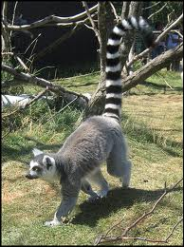
19. Stripe tailed ape double
Non V | Make 6
4 HS x | 790
5HS x | 750
6H | 980
Vul
4 HS x | 1190
5HS x | 1050
6H | 1430
3 ♥– 4 ♠– X
♠xx ♥ Qxxx ♦ Txxx ♣xxx

Slide 63
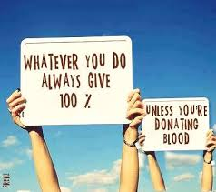
Playing Bridge some days we the pigeon and some days we are the statue. Hopefully after today we have more pigeons
Thanks for attending and sincere thanks to PERSONAL TRUST for sponsoring the event
I trust you will create more chances for yourself

